Slide 1
Lab Seminar
2024.08.20
16:00(UTC+9)
Seungwan Woo (UST)

Slide 2
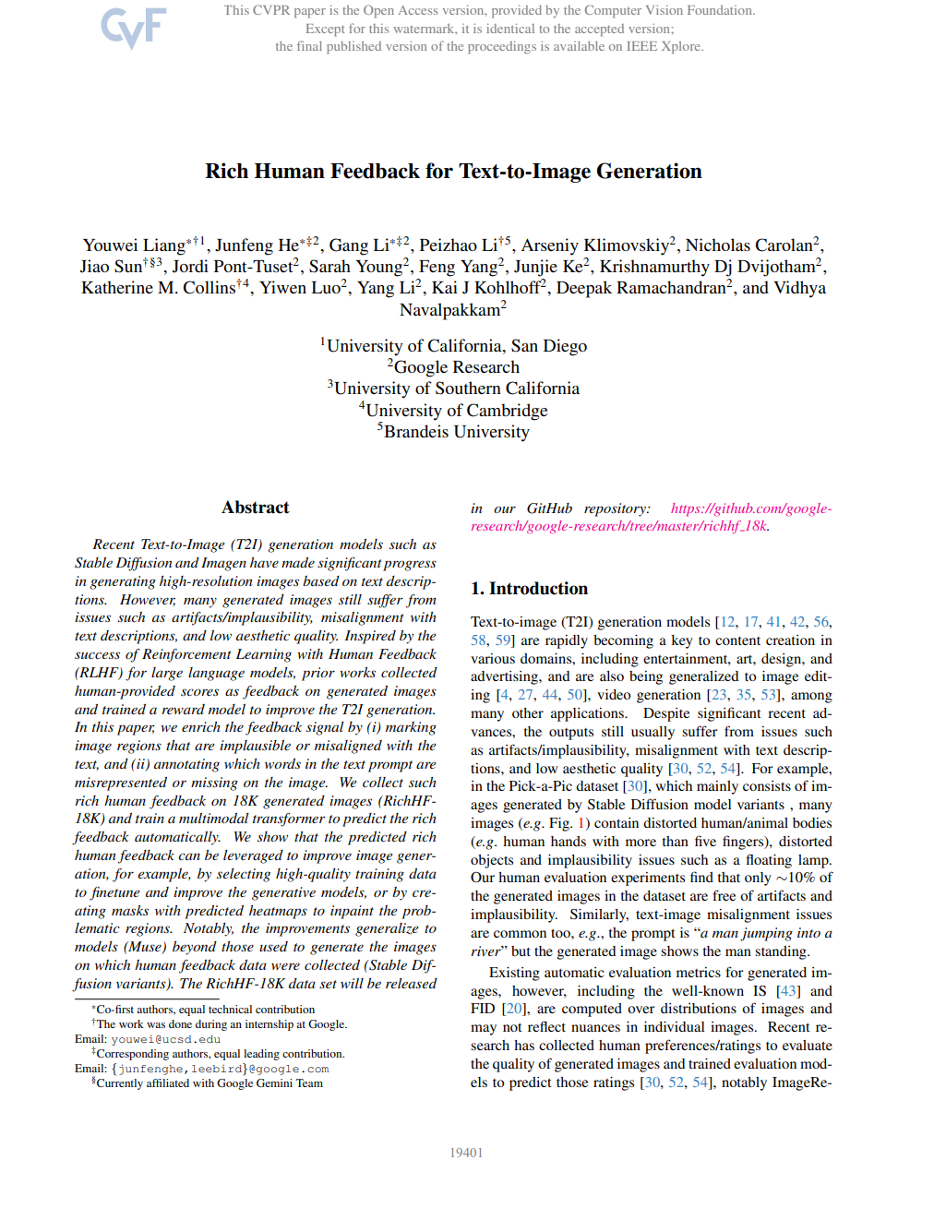
Rich Human Feedback for Text-to-Image Generation
CVPR 2024
Best paper
University of California, Google Research

Slide 3
Contents
Introduction
Method - Collecting rich human feedback
Method - Predicting rich human feedback
Experiments - Predicting rich human feedback
Learning from rich human feedback
Conclusion

Slide 4
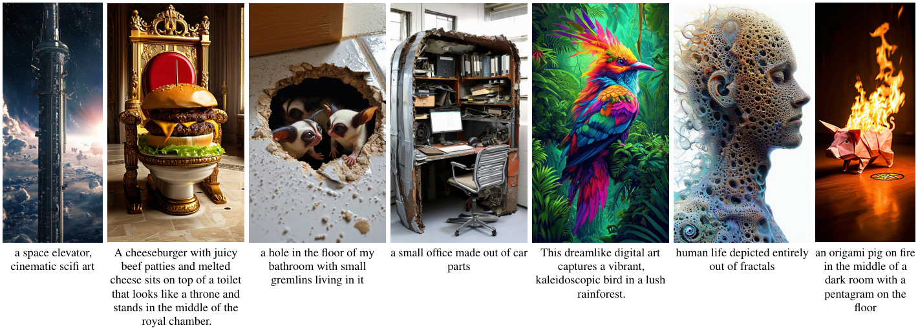
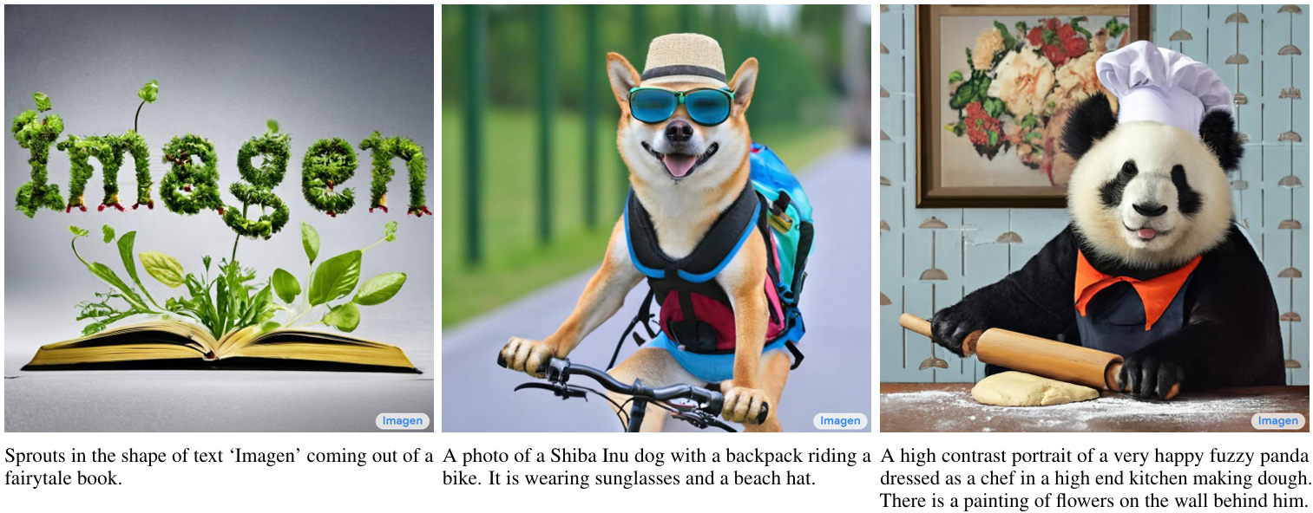
Liang, Youwei, et al. "Rich human feedback for text-to-image generation." Proceedings of the IEEE/CVF Conference on Computer Vision and Pattern Recognition. 2024.
Introduction
Stable Diffusion
Imagen

Slide 5
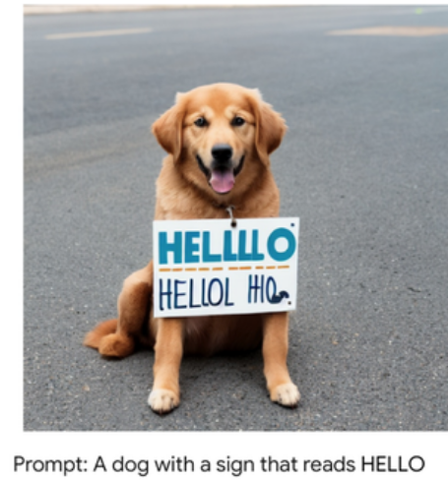
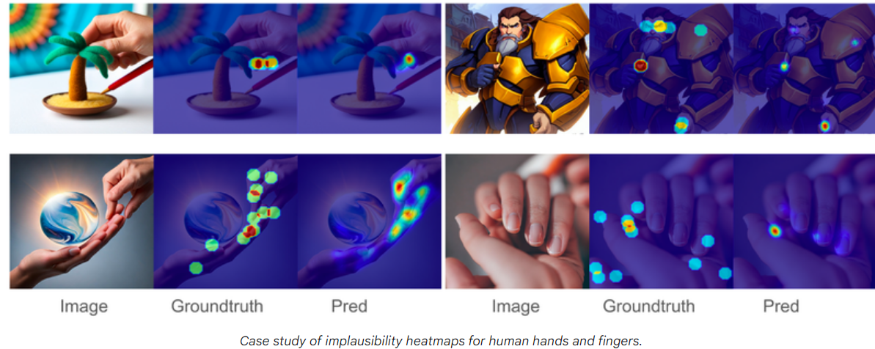
Liang, Youwei, et al. "Rich human feedback for text-to-image generation." Proceedings of the IEEE/CVF Conference on Computer Vision and Pattern Recognition. 2024.
Introduction

Slide 6
Liang, Youwei, et al. "Rich human feedback for text-to-image generation." Proceedings of the IEEE/CVF Conference on Computer Vision and Pattern Recognition. 2024.
Introduction
To address this, the authors collected detailed human feedback, which they used to suggest ways to improve the model.
It shows how rich human feedback contributes to improving image quality and text matching in Text-to-Image generation models used to suggest ways to improve the model.

Slide 7
Liang, Youwei, et al. "Rich human feedback for text-to-image generation." Proceedings of the IEEE/CVF Conference on Computer Vision and Pattern Recognition. 2024.
Method – Collecting rich human feedback
Collecting rich human feedback
Data collection process
Human feedback consolidation
RichHF-18K: a dataset of rich human feedback
Data statistics of RichHF-18K

Slide 8
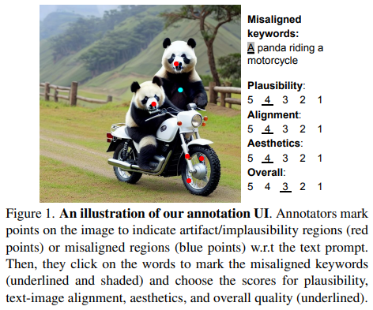
Liang, Youwei, et al. "Rich human feedback for text-to-image generation." Proceedings of the IEEE/CVF Conference on Computer Vision and Pattern Recognition. 2024.
Method – Collecting rich human feedback
1. Data collection process
The annotator(Human) examines each created image and analyzes the language prompt that was used to create it.
Place markers on the picture to show where there are implausibility/artifact or misalignments with the text prompt.
Label the misaligned keywords and the four types of scores for plausibility, image-text alignment, aesthetic, and overall quality, respectively, on a 5-point Likert scale.
Red points: artifact/implausibility regions
Blue points: misaligned regions

Slide 9
Liang, Youwei, et al. "Rich human feedback for text-to-image generation." Proceedings of the IEEE/CVF Conference on Computer Vision and Pattern Recognition. 2024.
Method – Collecting rich human feedback
2. Human feedback consolidation
To improve the reliability of the collected human feedback on generated images, three annotators annotate each image-text pair.
Therefore, need to consolidate the multiple annotations for each sample.
For the scores, simply average the scores from the multiple annotators for an image to obtain the final score.
For the point annotations, first convert them to heatmaps for each annotation, where each point is converted to the heatmap, and then we compute the average heatmap across annotators.
For the point annotations, first convert them to heatmaps for each annotation, where each point is converted to the heatmap, and then we compute the average heatmap across annotators.
The regions with clear implausibility are likely to be annotated by all annotators and have a high value on the final average heatmap.

Slide 10
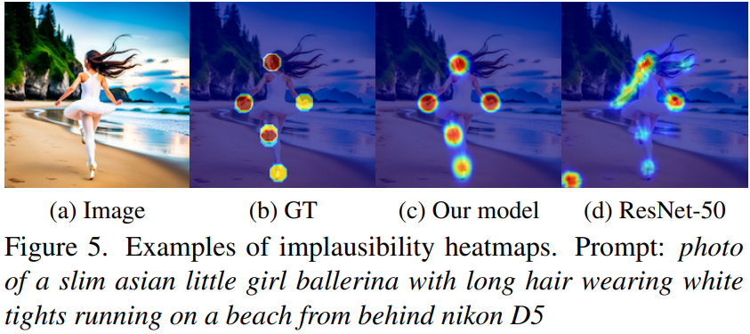
Liang, Youwei, et al. "Rich human feedback for text-to-image generation." Proceedings of the IEEE/CVF Conference on Computer Vision and Pattern Recognition. 2024.
Method – Collecting rich human feedback
2. Human feedback consolidation

Slide 11
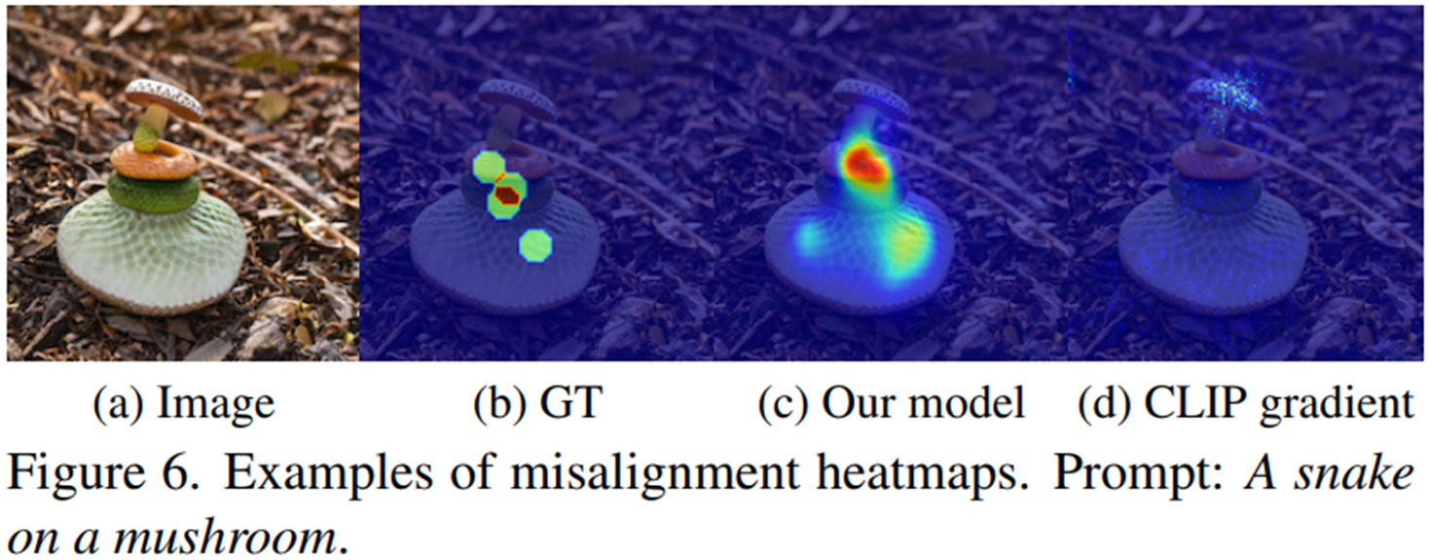
Liang, Youwei, et al. "Rich human feedback for text-to-image generation." Proceedings of the IEEE/CVF Conference on Computer Vision and Pattern Recognition. 2024.
Method – Collecting rich human feedback
2. Human feedback consolidation

Slide 12
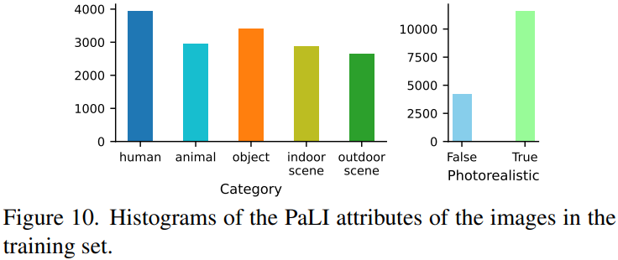
Liang, Youwei, et al. "Rich human feedback for text-to-image generation." Proceedings of the IEEE/CVF Conference on Computer Vision and Pattern Recognition. 2024.
Method – Collecting rich human feedback
3. RichHF-18K: a dataset of rich human feedback
Sample image-text pairs from the Pick-a-Pic dataset for annotation, as shown in Figure 1.
Sampling data around photo-realistic images to create a photo-realistic dataset
Extract data sample features using the PaLI visual question answering model to determine if an image is realistic and select the category that best describes the image (one of people, animals, objects, indoors, outdoors).
Generated 17K image-text pairs with PaLI answers
1K additional pairs of unique (non-common) prompts and corresponding images from the Pick-a-Pic dataset.
Create a total of 18K datasets (16K training, 1K validation, 1K testing)

Slide 13
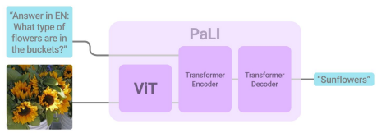
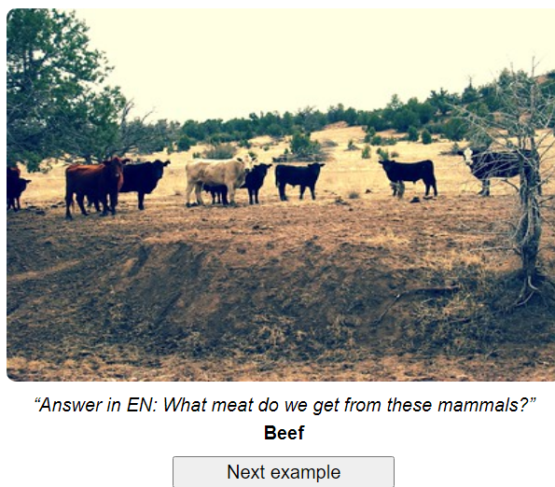
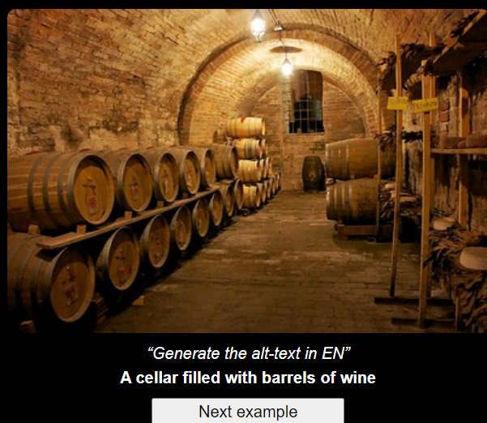
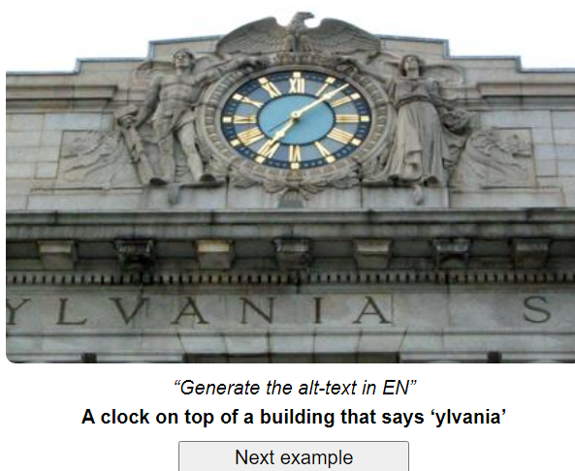
Liang, Youwei, et al. "Rich human feedback for text-to-image generation." Proceedings of the IEEE/CVF Conference on Computer Vision and Pattern Recognition. 2024.
Method – Collecting rich human feedback
PaLI: A JOINTLY-SCALED MULTILINGUAL LANGUAGE-IMAGE MODEL
Visual question answering
Image captioning
Scene-text-oriented examples

Slide 14
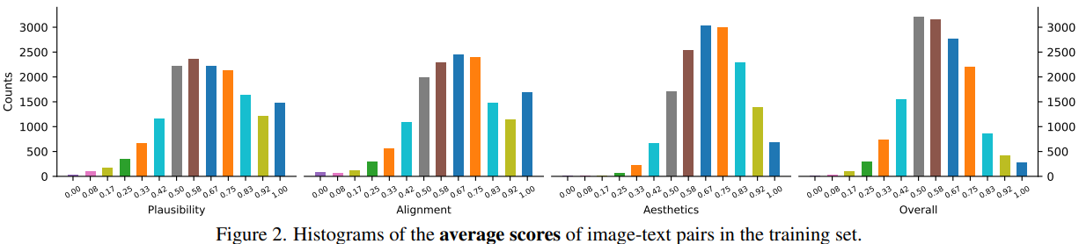
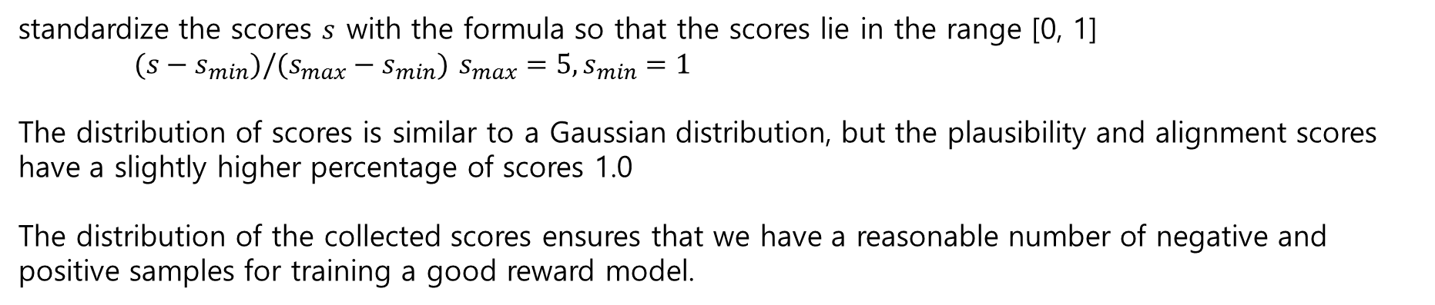
Liang, Youwei, et al. "Rich human feedback for text-to-image generation." Proceedings of the IEEE/CVF Conference on Computer Vision and Pattern Recognition. 2024.
Method – Collecting rich human feedback
4. Data statistics of RichHF-18K
standardize the scores $s$ with the formula so that the scores lie in the range [0, 1]
$(s−s_{min})/(s_{max}−s_{min})$ $s_{max}=5, s_{min}=1$
The distribution of scores is similar to a Gaussian distribution, but the plausibility and alignment scores have a slightly higher percentage of scores 1.0
The distribution of the collected scores ensures that we have a reasonable number of negative and positive samples for training a good reward model.

Slide 15
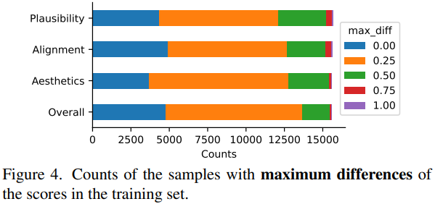
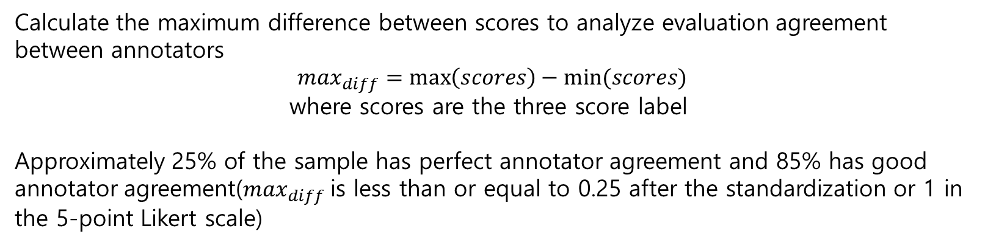
Liang, Youwei, et al. "Rich human feedback for text-to-image generation." Proceedings of the IEEE/CVF Conference on Computer Vision and Pattern Recognition. 2024.
Method – Collecting rich human feedback
4. Data statistics of RichHF-18K
Calculate the maximum difference between scores to analyze evaluation agreement between annotators
$$\max_{diff}=\max\left(scores\right)−min⁡(scores)$$
where scores are the three score label
Approximately 25% of the sample has perfect annotator agreement and 85% has good annotator agreement($\max_{diff}$is less than or equal to 0.25 after the standardization or 1 in the 5-point Likert scale)

Slide 16
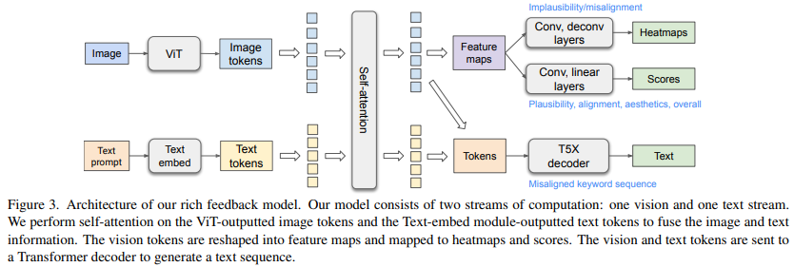
Liang, Youwei, et al. "Rich human feedback for text-to-image generation." Proceedings of the IEEE/CVF Conference on Computer Vision and Pattern Recognition. 2024.
Method – Predicting rich human feedback
Ex) Misaligned keyword sequence (_0 is special suffix for each misaligned token)
Image Input: Black cat image T5X decoder prediction: Yellow_0 cat image
Text Input: Yellow cat image

Slide 17
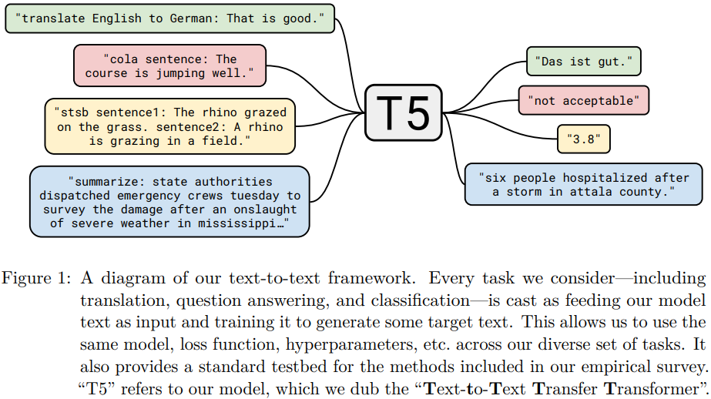
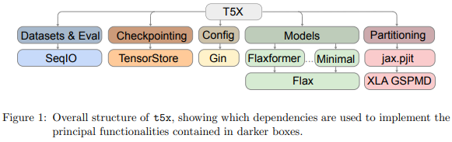
Liang, Youwei, et al. "Rich human feedback for text-to-image generation." Proceedings of the IEEE/CVF Conference on Computer Vision and Pattern Recognition. 2024.
Method – Predicting rich human feedback
Text-to-Text Transfer Transformer: T5
T5X

Slide 18
Liang, Youwei, et al. "Rich human feedback for text-to-image generation." Proceedings of the IEEE/CVF Conference on Computer Vision and Pattern Recognition. 2024.
Method – Predicting rich human feedback
Two variants of this architecture: Multi-head (Blue box) and Augmented prompt(Green box).

Slide 19
Liang, Youwei, et al. "Rich human feedback for text-to-image generation." Proceedings of the IEEE/CVF Conference on Computer Vision and Pattern Recognition. 2024.
Experiments – Predicting rich human feedback
This model is trained on the 16K RichHF-18K training samples.
The hyperparameters were tuned using the model performance on the 1K RichHF-18K validation set.
For score prediction tasks, report the Pearson linear correlation coefficient (PLCC) and Spearman rank correlation coefficient (SRCC), which are typical evaluation metrics for score predictions.
For heatmap prediction tasks, a straightforward way to evaluate the results would be to borrow standard saliency heatmap evaluation metrics such as NSS/KLD
However, these metrics cannot be applied directly in our case as all these metrics assume the ground truth heatmap is not empty; yet in our case, empty ground truth is possible (e.g., for artifact/implausibility heatmap, it means the image does not have any artifact/implausibility).
As such, we report MSE on all samples and on those with empty ground truth, respectively, and report saliency heatmap evaluation metrics like NSS/KLD/AUC-Judd/SIM/CC for the samples with non-empty ground truth.
Heatmap empty: photo-realistic Heatmap non-empty: artificial

Slide 20
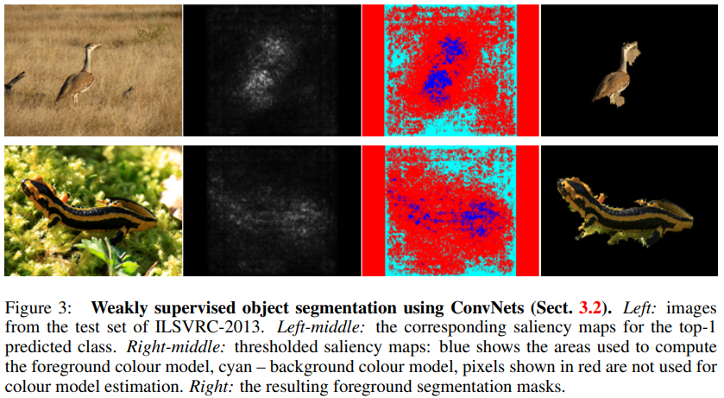
Liang, Youwei, et al. "Rich human feedback for text-to-image generation." Proceedings of the IEEE/CVF Conference on Computer Vision and Pattern Recognition. 2024.
Experiments – Predicting rich human feedback
For the misaligned keyword sequence prediction, we adopt the token-level precision, recall, and F1-score.
The comparison model used ResNet-50 and CLIP models, with ResNet-50 using multiple fully connected layer and deconvolution heads to predict the score and heatmaps.
CLIP used as the basis for calculating the image-to-text alignment score, and CLIP gradient was used as the basis for heatmap prediction.

Slide 21
Liang, Youwei, et al. "Rich human feedback for text-to-image generation." Proceedings of the IEEE/CVF Conference on Computer Vision and Pattern Recognition. 2024.
Experiments – Predicting rich human feedback
PLCC: A metric that indicates the linear correlation between two images.
SRCC: A metric that evaluates how well the order of pixel values or features is preserved between two images.
CC: A metric that represents the overall correlation between two images.
KLD: A metric that quantifies the difference between the probability distributions of two images.
SSIM: A metric that assesses the structural similarity between two images.
NSS: A metric that measures how well the visual attention pattern predicted by a model matches actual human attention.
AUC-Judd: A metric that evaluates how well the predicted attention regions match the actual attention regions.

Slide 22
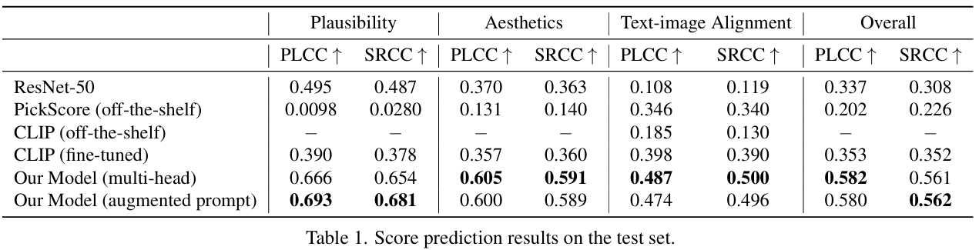
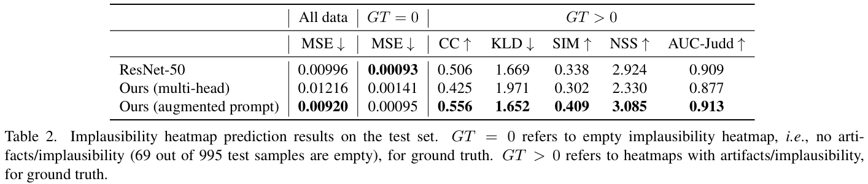
Liang, Youwei, et al. "Rich human feedback for text-to-image generation." Proceedings of the IEEE/CVF Conference on Computer Vision and Pattern Recognition. 2024.
Experiments – Predicting rich human feedback

Slide 23
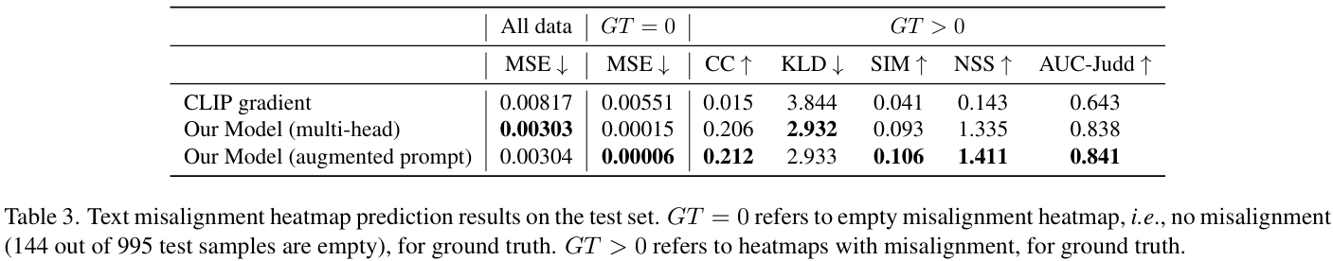
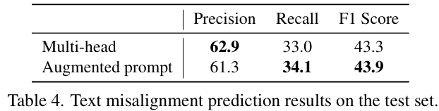
Liang, Youwei, et al. "Rich human feedback for text-to-image generation." Proceedings of the IEEE/CVF Conference on Computer Vision and Pattern Recognition. 2024.
Experiments – Predicting rich human feedback

Slide 24
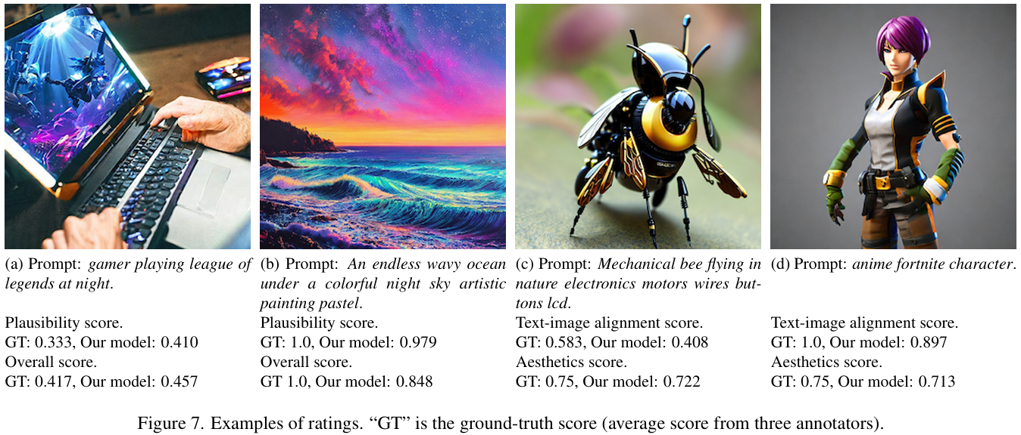
Liang, Youwei, et al. "Rich human feedback for text-to-image generation." Proceedings of the IEEE/CVF Conference on Computer Vision and Pattern Recognition. 2024.
Experiments – Predicting rich human feedback

Slide 25
Liang, Youwei, et al. "Rich human feedback for text-to-image generation." Proceedings of the IEEE/CVF Conference on Computer Vision and Pattern Recognition. 2024.
Learning from rich human feedback
Investigate whether the predicted rich human feedback (e.g., scores and heatmaps) can be used to improve image generation.
Generated 8 images for each of 12,564 prompts using pre-trained Muse models.
Predict the RAHF score for each image, and if the highest score for an image is above a certain threshold, add that image to the finetuning dataset
The Muse model is then finetuned with this dataset. This approach could be viewed as a simplified version of Direct Preference Optimization

Slide 26
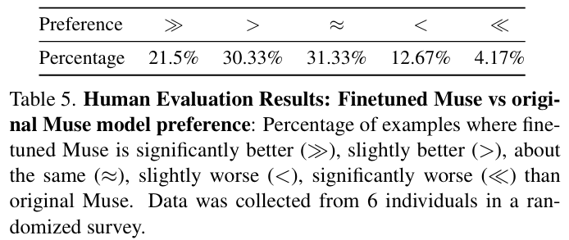
Liang, Youwei, et al. "Rich human feedback for text-to-image generation." Proceedings of the IEEE/CVF Conference on Computer Vision and Pattern Recognition. 2024.
Learning from rich human feedback
Create an image using 100 new prompts, and ask six annotators to compare two images side-by-side, one from Muse and one from the fine-tuned Muse.
Left side: fine-tuned Muse, Right side: original Muse

Slide 27
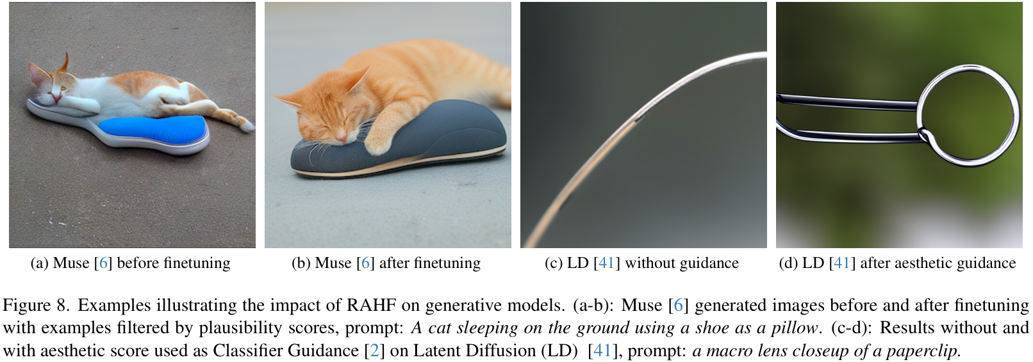
Liang, Youwei, et al. "Rich human feedback for text-to-image generation." Proceedings of the IEEE/CVF Conference on Computer Vision and Pattern Recognition. 2024.
Learning from rich human feedback

Slide 28
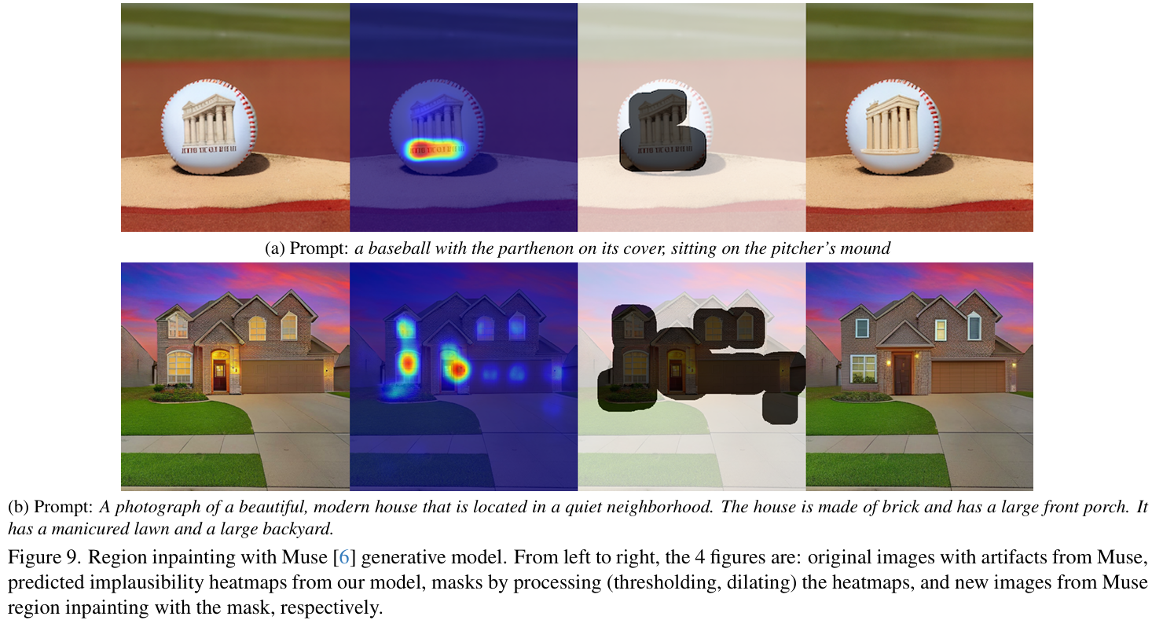
Liang, Youwei, et al. "Rich human feedback for text-to-image generation." Proceedings of the IEEE/CVF Conference on Computer Vision and Pattern Recognition. 2024.
Learning from rich human feedback

Slide 29
Liang, Youwei, et al. "Rich human feedback for text-to-image generation." Proceedings of the IEEE/CVF Conference on Computer Vision and Pattern Recognition. 2024.
Conclusion
Why I reviewed this paper?
I think that…
It is very important to create realistic images
This paper demonstrates the use of rich human feedback to create realistic image datasets and improve performance on existing models.
It would be nice to have this rich human feedback, but I think it would take too much time and money.
I think that by providing some sort of guide image and applying reinforcement learning to the model, we can create realistic images with less human effort.

Slide 30
Thank you!

